Slide 1

YAY! - Celebrating Education

Slide 2


Python Course
(Basics)

Slide 3
How to make Tic Tac Toe in Python

Slide 4
Agenda for Today
Introduction
What are we going to do?

Slide 5
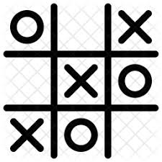
Introduction
We are going to build a two-player tic-tac-toe game, which we will be able to play against the computer. Initially, we’ll make an empty game board and then we’ll take inputs from the players and we’ll check for the winning condition and if the whole board gets filled, the results will be declared as “You won” or “You lost”.

Slide 6
What are we going to do?
We are going to build the game using Python.
Step 1- Design the board.( The typical Tic Tac Toe game board.)
Step 2- Declare the possible moves.
Step 3- Program the winning combinations.
Step 4- Write a function to display the board.
Step 5- Using the random library, program the Computer’s moves.
Step 6- Write a function to check whether the move is valid.

Slide 7
What are we going to do?
Step 7 – Write a function to check whether you can win the game.
Step 8- Write a function to make the move on the board.
Step 9- Write a function for the Computer and program its future moves.
Step 10- Write a function to check for overflow.
Step 11- Write the main method.
(i) Ask the user to enter their moves.
(ii) Call the required functions to run the game.
(iii)Display the results.

Slide 8
Thank You!
See you in the next class!

